Slide 1
4.3 Determinants & Cramer’s Rule

Slide 2
Objectives/Assignment

Slide 3
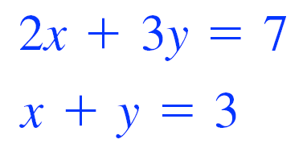
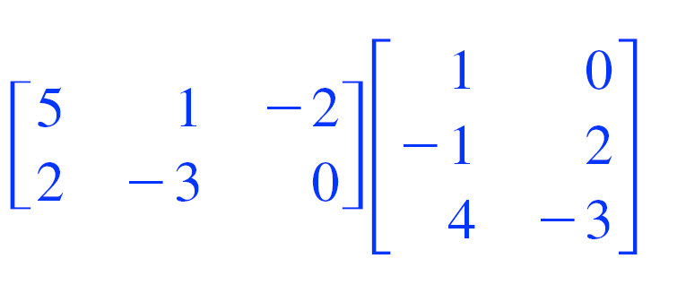
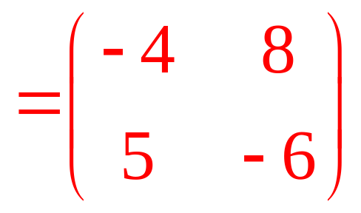
Warm-Up
Solve the system of equations:
(2,1)
What is the product of these matrices?

Slide 4
Associated with each square matrix is a real number called it’s determinant.
We write The Determinant of matrix A as det A or |A|

Slide 5
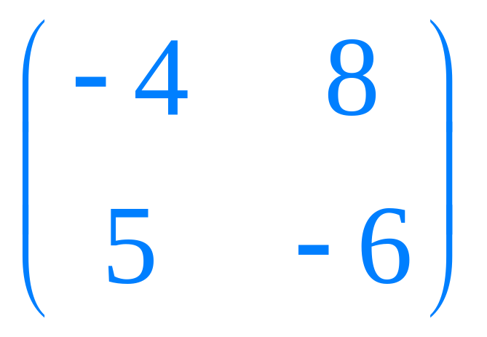
Here’s how to find the determinant of a square 2 x 2 matrix:
Multiply
40 (2nd )
Multiply
24 (1st)
Now subtract these two numbers.
-
24 (1st)
40 (2nd )
-16 is the determinant of this matrix
= -16

Slide 6
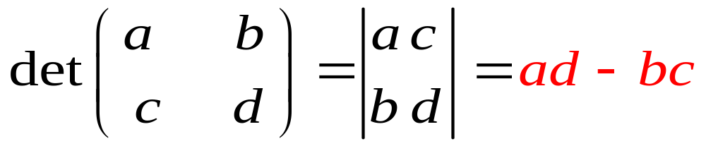
In General

Slide 7
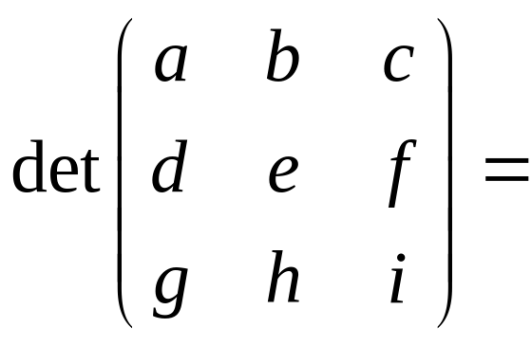
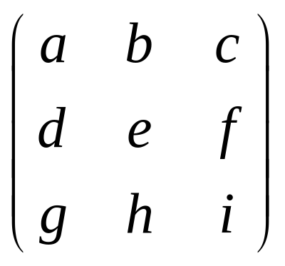
Determinant of a 3 x 3 Matrix
(gec
+hfa
+idb)
Now Subtract the 2nd set products from the 1st.
a b
d e
(aei + bfg + cdh) - (gec + hfa + idb)
g h
(aei+
bfg
+cdh)

Slide 8
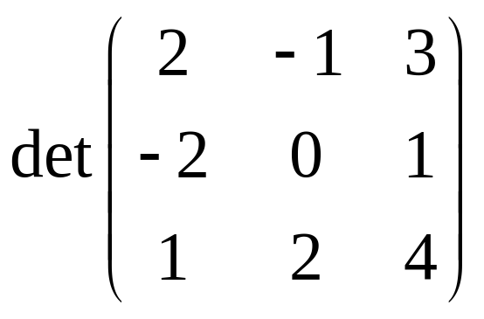
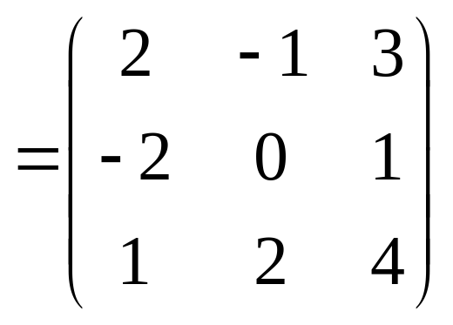
Compute the Determinant of this 3 x 3 Matrix
(0
+4
+8)
Now Subtract the 2nd set products from the 1st.
2 -1
-2 0
=-25
(-13) - (12)
1 2
(0+
-1
-12)

Slide 9
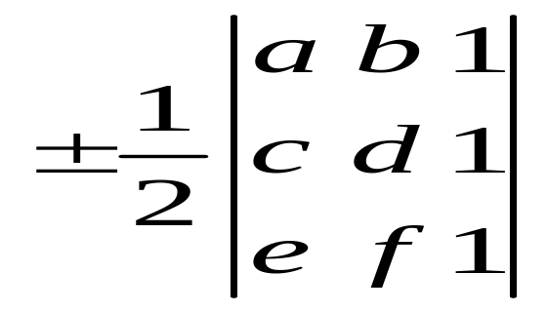
You can use a determinant to find the Area of a Triangle
(a,b)
The Area of a triangle with verticies (a,b), (c,d) and (e,f) is given by:
(e,f)
(c,d)
Where the plus or minus sign indicates that the appropriate sign should be chosen to give a positive value answer for the Area.

Slide 10
You can use determinants to solve a system of equations. The method is called Cramer’ rule and named after the Swiss mathematician Gabriel Cramer (1704-1752). The method uses the coefficients of the linear system in a clever way.
ax + by = e
In general the solution to the system
is (x,y)
cx + dy = f
e
b
f
d
x=
a
b
c
d
where
a
b
and
= 0
c
d
a
e
c
f
If we let A be the coefficient matrix of the linear system, notice this is just det A.
y=
a
b
c
d

Slide 11
Use Cramer’s Rule to solve this system:
4x + 2y = 10
ax + by = e
5x + y = 17
cx + dy = f
1
e
b
10
2
f
d
17
1
(10)(1) –(17)(2)
10 - 34
-24
x=
x=
=
=
=
= 4
(4)(1) –(5)(2)
4 - 10
-6
a
b
4
2
c
d
5
1
a
e
4
10
c
f
5
17
(4)(17) –(5)(10)
68 - 50
18
y=
y=
=
=
=
-6
= -3
4
2
(4)(1) –(5)(2)
4 - 10
a
b
c
d
5
1
The system has a unique solution at (4,-3)

Slide 12
Solve the following system of equations using Cramer’s Rule:
6x + 4y = 10
ax + by = e
3x + 2y = 5
cx + dy = f
e
b
10
4
f
d
5
2
(10)(2) –(5)(4)
20 - 20
0
x=
x=
=
=
=
0
a
b
6
4
(6)(2) –(3)(4)
12 - 12
c
d
3
2
Since, the determinant from the denominator is zero, and division by zero is not defined: THIS SYSTEM DOES NOT HAVE A UNIQUE SOLUTION and Cramer’s Rule can’t be used.

Slide 13
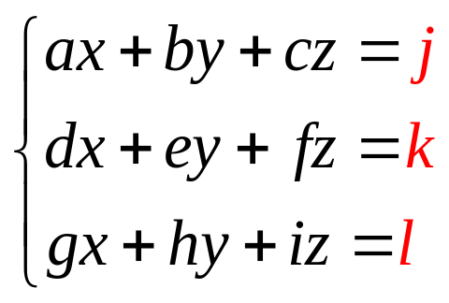
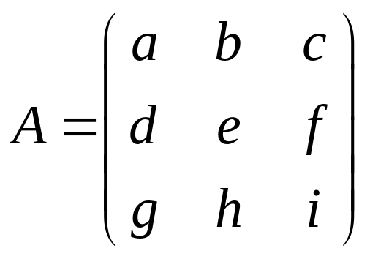
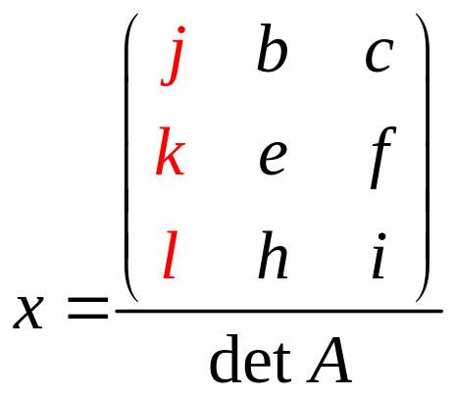
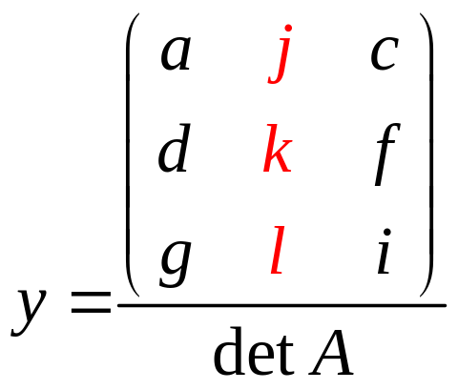
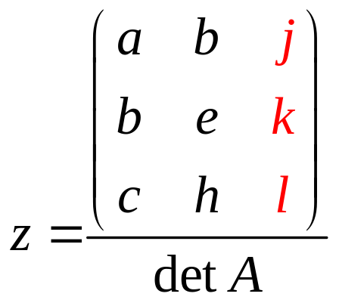
Cramer’ Rule can be use to solve a 3 x 3 system.
Let A be the coefficient matrix of this linear system:
If det A is not 0, then the system has exactly one solution. The solution is:

